Slide 1

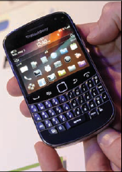
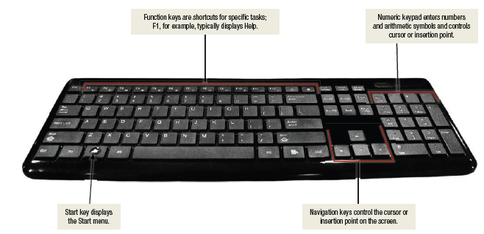
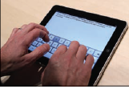
Keyboard Entry
Keyboards
Traditional keyboards
Laptop keyboards
Virtual keyboards
Thumb keyboards
Laptop keyboard
Virtual keyboard
Thumb keyboard
Notes:
Keyboards (key term) come in a variety of designs – most common way to input data
Range from full-sized to miniature and from rigid to flexible
Common types
Traditional keyboard (key term) – full sized, rigid, rectangular keyboards that include function, navigational, and numeric keys
Laptop keyboard (key term) – used on laptop computers
Virtual keyboard (key term) – keyboard for a tablet PC and mobile devices– shown on a touch screen
Thumb keyboard (key term) – used on smartphones

Slide 2
Keyboard Entry – Traditional Keyboard
Notes:
Keyboards (key term) come in a variety of designs – most common way to input data
Range from full-sized to miniature and from rigid to flexible
Common types
Traditional keyboard (key term) – full sized, rigid, rectangular keyboards that include function, navigational, and numeric keys
Laptop keyboard (key term) – used on laptop computers
Virtual keyboard (key term) – keyboard for a tablet PC and mobile devices– shown on a touch screen
Thumb keyboard (key term) – used on smartphones

Slide 3
Keyboard Entry – Laptop Keyboard
Notes:
Keyboards (key term) come in a variety of designs – most common way to input data
Range from full-sized to miniature and from rigid to flexible
Common types
Traditional keyboard (key term) – full sized, rigid, rectangular keyboards that include function, navigational, and numeric keys
Laptop keyboard (key term) – used on laptop computers
Virtual keyboard (key term) – keyboard for a tablet PC and mobile devices– shown on a touch screen
Thumb keyboard (key term) – used on smartphones

Slide 4
Keyboard Entry – Virtual Keyboard
Notes:
Keyboards (key term) come in a variety of designs – most common way to input data
Range from full-sized to miniature and from rigid to flexible
Common types
Traditional keyboard (key term) – full sized, rigid, rectangular keyboards that include function, navigational, and numeric keys
Laptop keyboard (key term) – used on laptop computers
Virtual keyboard (key term) – keyboard for a tablet PC and mobile devices– shown on a touch screen
Thumb keyboard (key term) – used on smartphones

Slide 5
Keyboard Entry – Thumb Keyboard
Notes:
Keyboards (key term) come in a variety of designs – most common way to input data
Range from full-sized to miniature and from rigid to flexible
Common types
Traditional keyboard (key term) – full sized, rigid, rectangular keyboards that include function, navigational, and numeric keys
Laptop keyboard (key term) – used on laptop computers
Virtual keyboard (key term) – keyboard for a tablet PC and mobile devices– shown on a touch screen
Thumb keyboard (key term) – used on smartphones

Slide 6
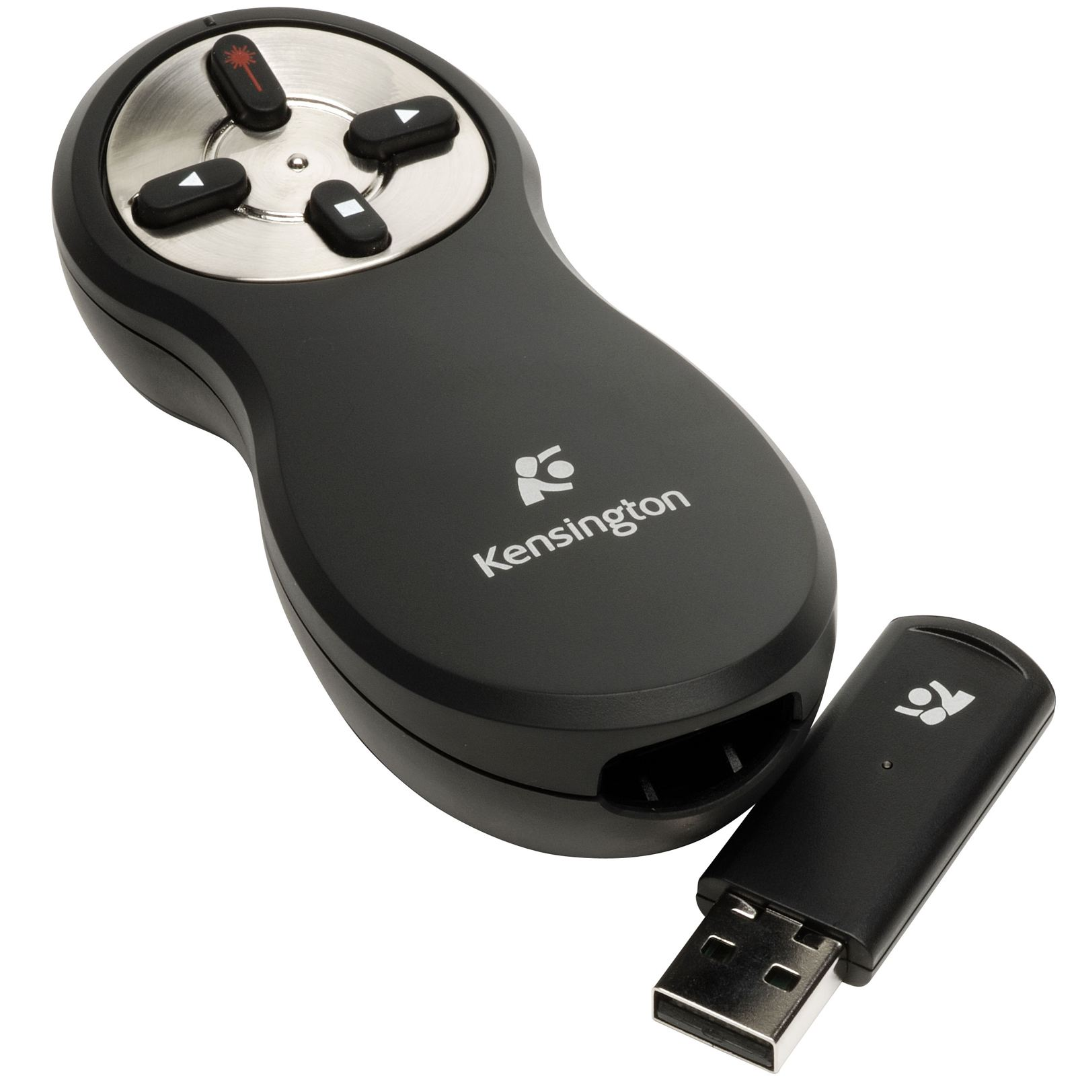
Presentation Remote

